Slide 1
Troubleshooting vSphere Clusters
Module 6

Slide 2
Importance
As you scale your VMware vSphere® environment, you must be aware of the vSphere features and functions that help you manage the hosts in your environment.
The vSphere administrator must be able to identify and troubleshoot VMware vSphere® High Availability, VMware vSphere® vMotion®, and VMware vSphere® Storage DRSTM problems to keep the cluster running properly and continuously.

Slide 3
You Are Here
Course Introduction
Introduction to Troubleshooting
Troubleshooting Tools
Troubleshooting Virtual Networking
Troubleshooting Storage
Troubleshooting vSphere Clusters
Troubleshooting vCenter Server and ESXi
Troubleshooting Virtual Machines

Slide 4
Learner Objectives
By the end of this module, you should be able to meet the following objectives:
Identify and troubleshoot vSphere HA problems
Analyze and solve vSphere vMotion problems
Diagnose and troubleshoot common VMware vSphere® Distributed Resource Scheduler problems

Slide 5
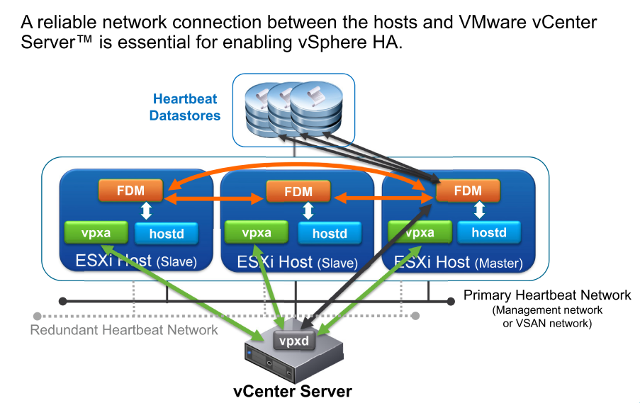
Review of vSphere HA

Slide 6
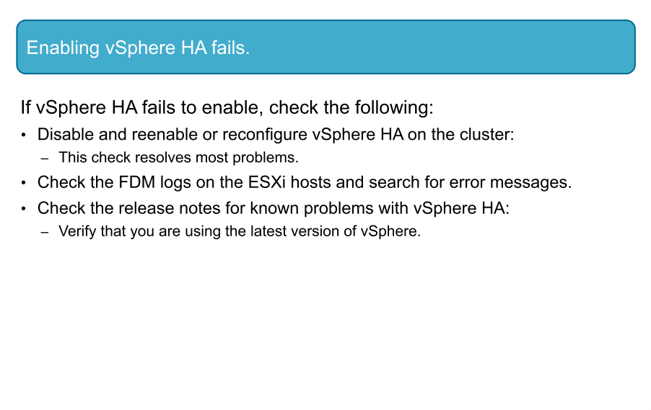
vSphere HA Problem 1

Slide 7
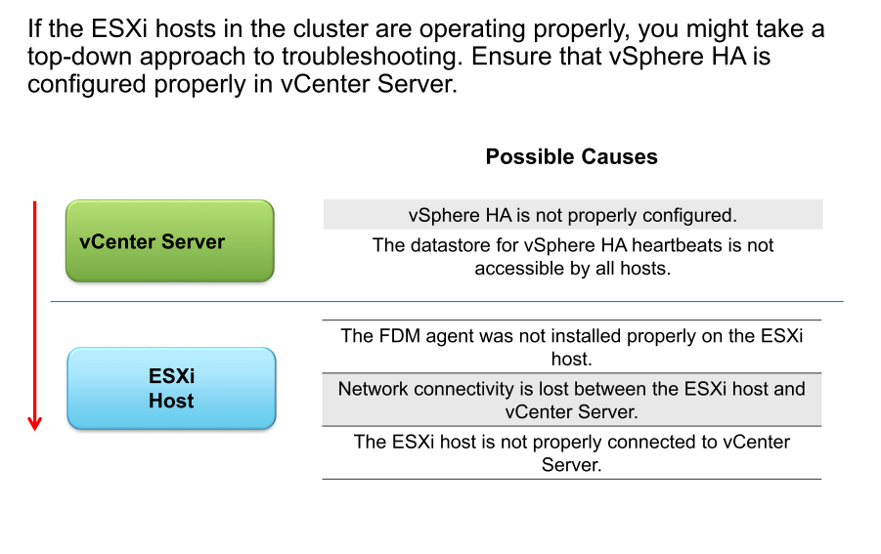
Identifying Possible Causes

Slide 8
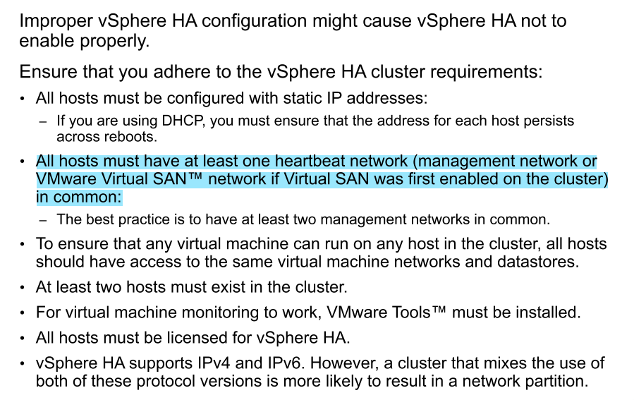
Possible Cause: Not Meeting vSphere HA Requirements

Slide 9
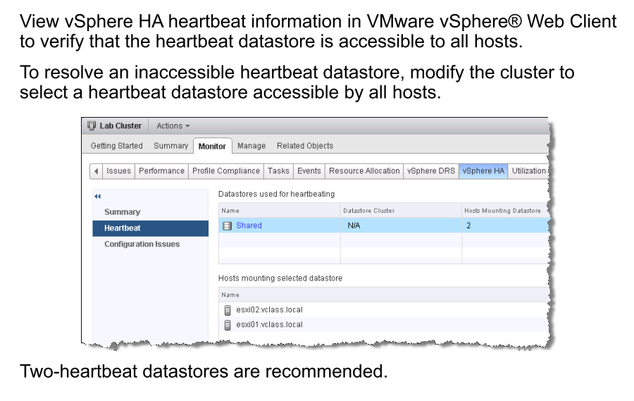
Possible Cause: Heartbeat Datastore Inaccessible

Slide 10
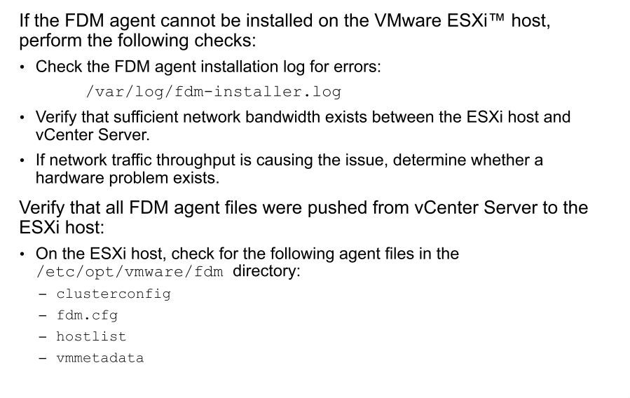
Possible Cause: FDM Agent Not Installing on ESXi Host

Slide 11
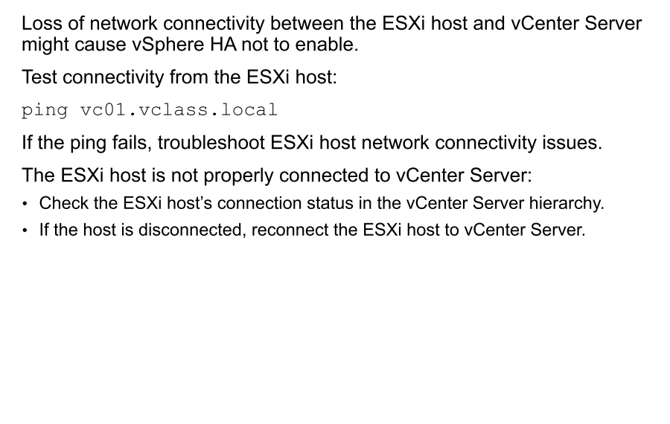
Possible Cause: Lost Host Connectivity

Slide 12
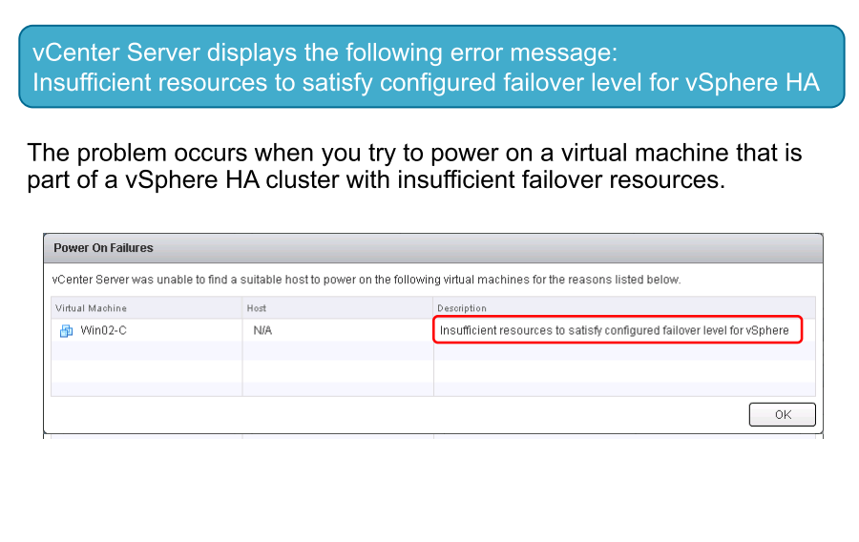
vSphere HA Problem 2

Slide 13
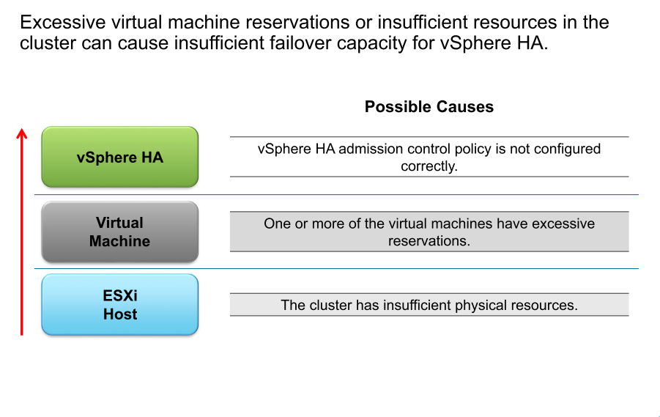
Identifying Possible Causes

Slide 14
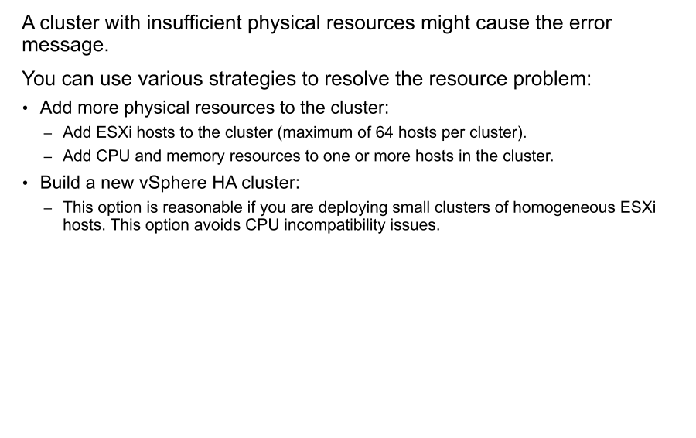
Possible Cause: Insufficient Physical Resources

Slide 15
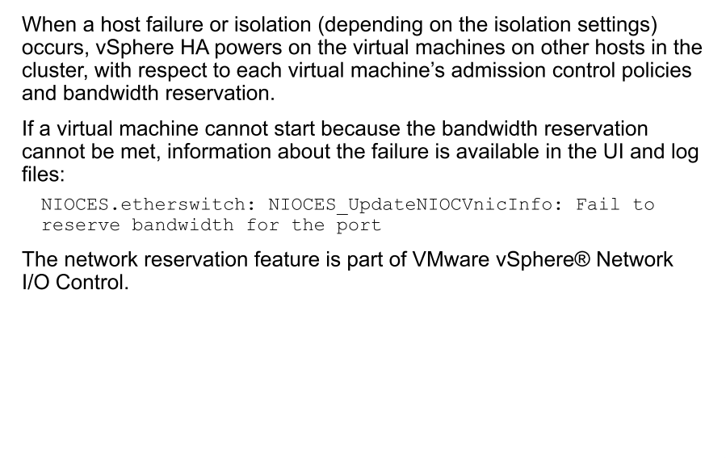
Bandwidth Reservation

Slide 16
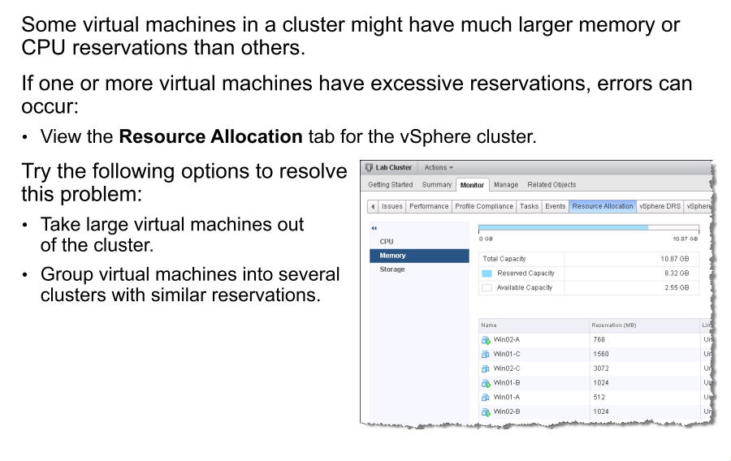
Possible Cause: Excessive Virtual Machine Reservations

Slide 17
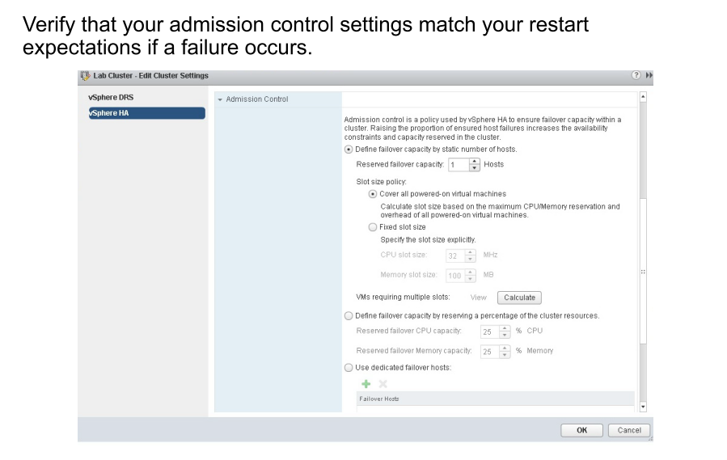
Possible Cause: Admission Control Policy Misconfiguration

Slide 18
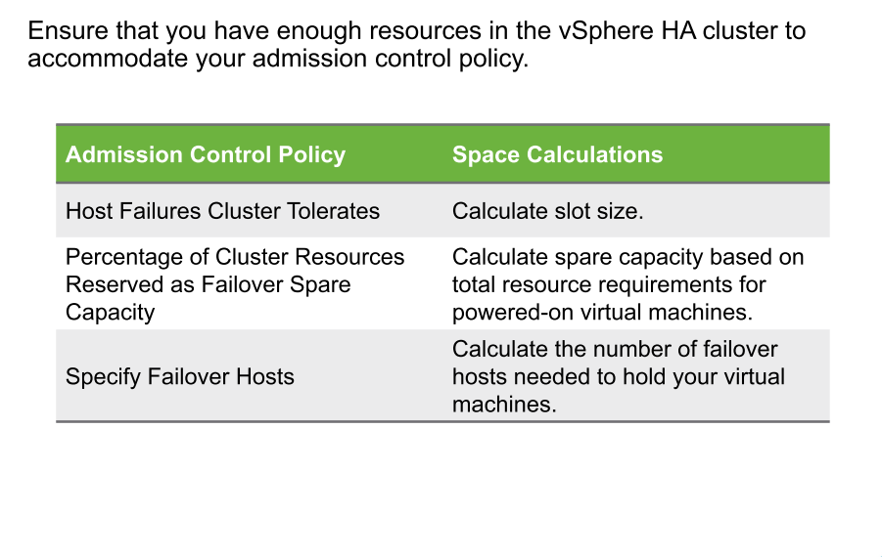
vSphere HA Cluster: Admission Control Guidelines

Slide 19
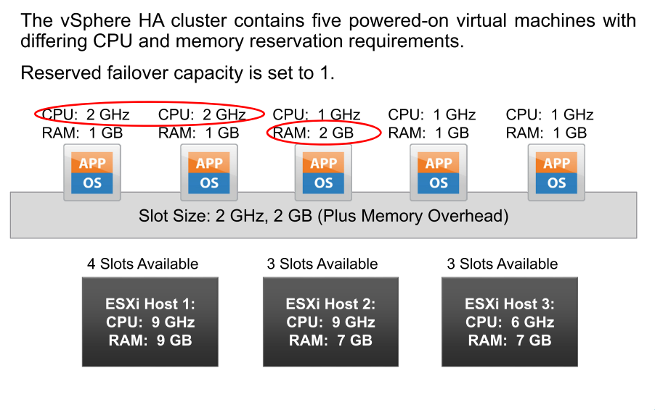
Example of Calculating Slot Size

Slide 20
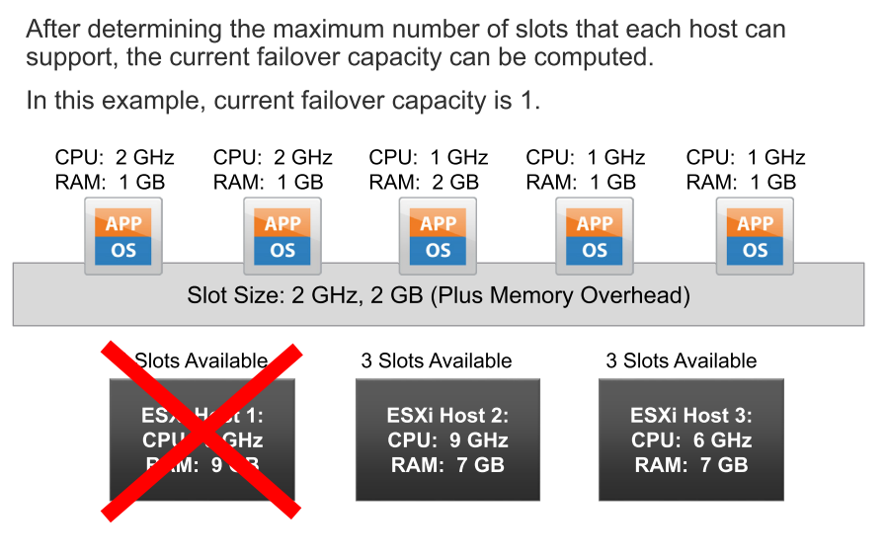
Applying Slot Size

Slide 21
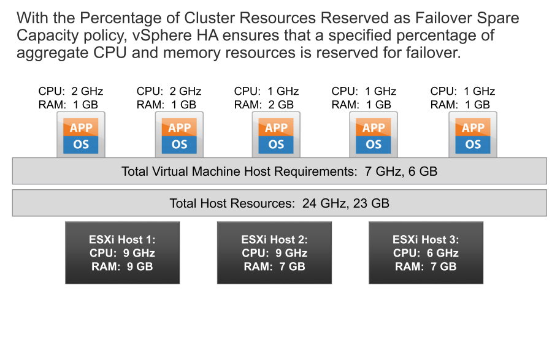
Reserving a Percentage of Cluster Resources

Slide 22
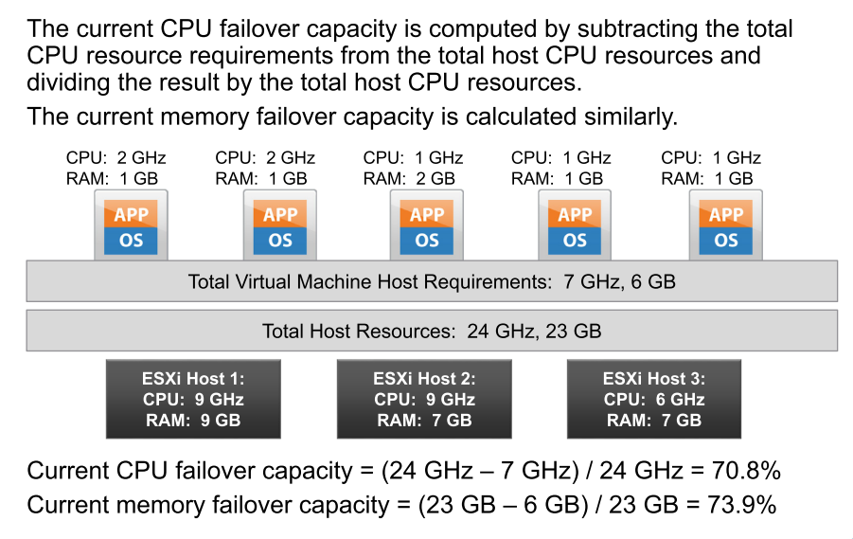
Calculating Current Failover Capacity

Slide 23
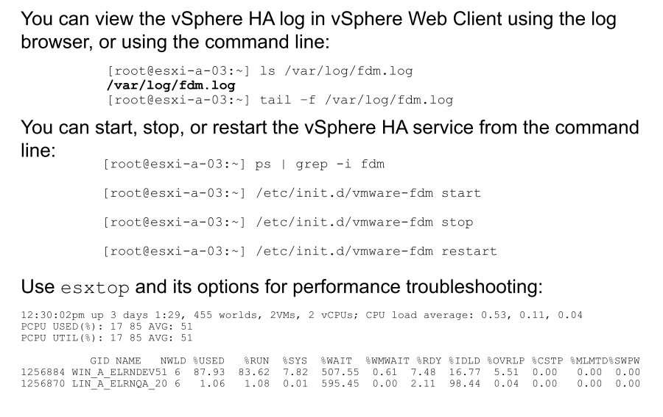
Useful Troubleshooting Commands

Slide 24
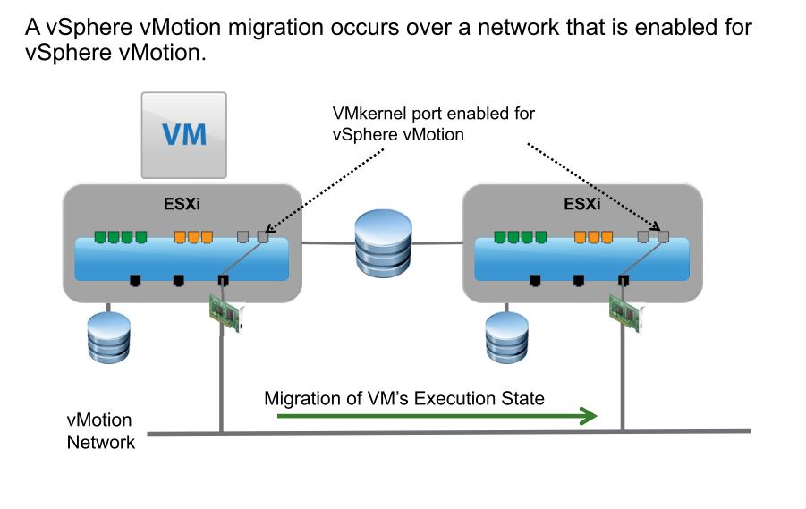
Review of vSphere vMotion

Slide 25
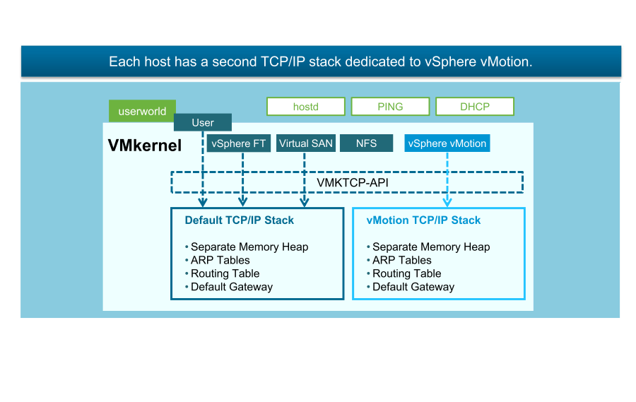
vSphere vMotion TCP/IP Stacks

Slide 26
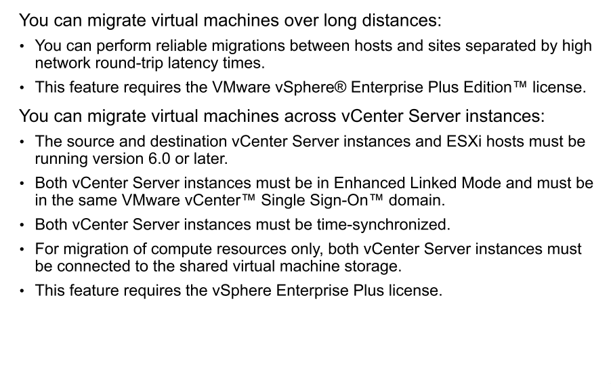
Long Distance vMotion and Cross vCenter Server vMotion

Slide 27
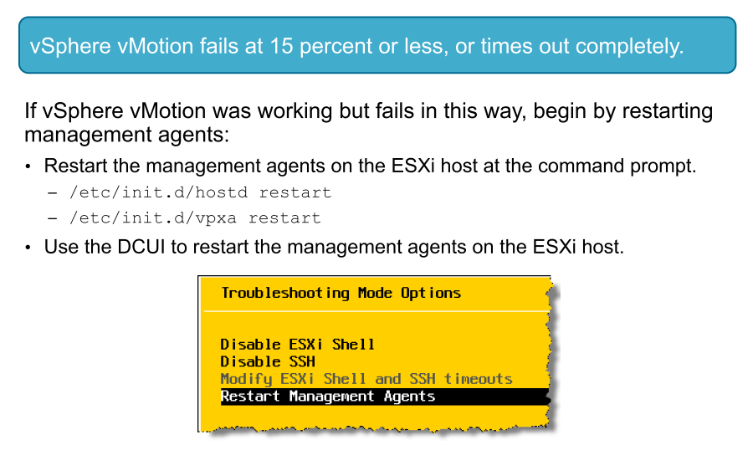
vSphere vMotion Problem 1

Slide 28
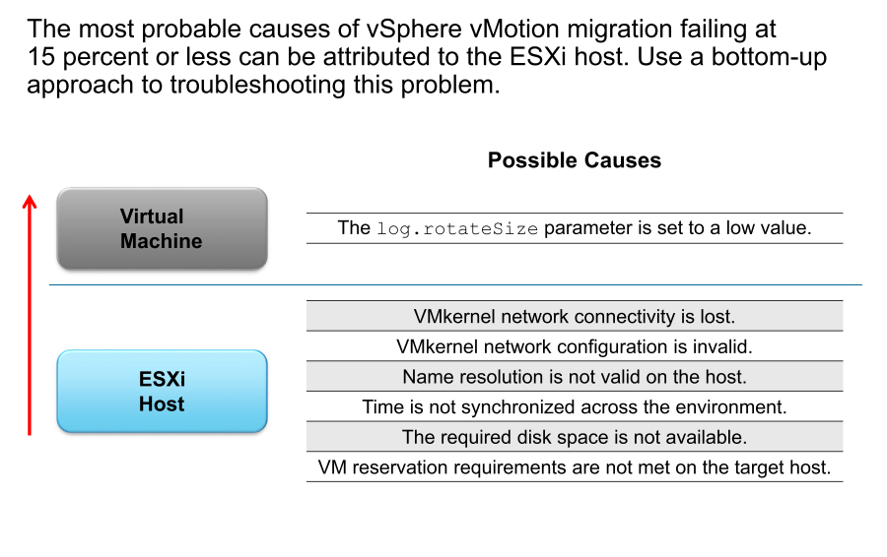
Identifying Possible Causes

Slide 29
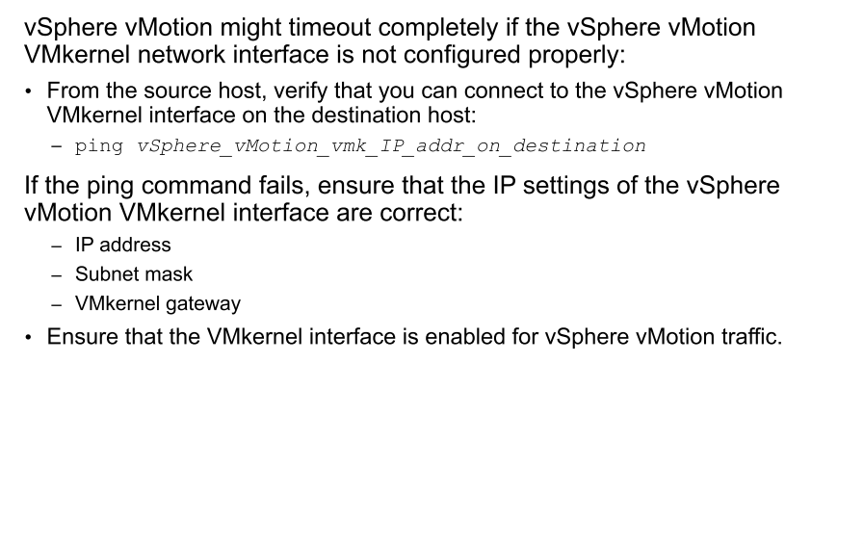
Possible Cause: VMkernel Interface Misconfiguration

Slide 30
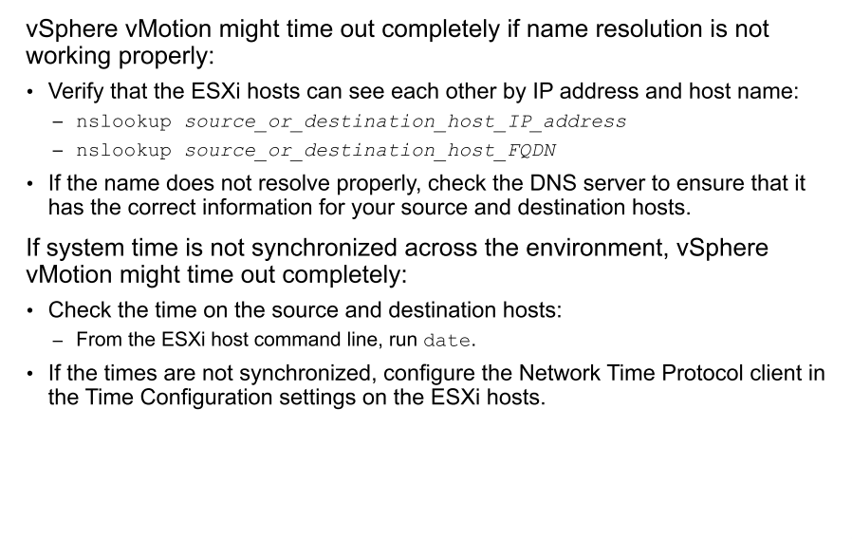
Possible Cause: Environment Misconfiguration

Slide 31
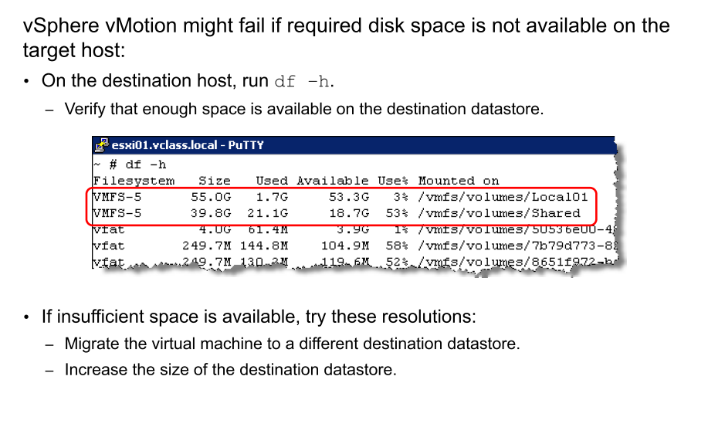
Possible Cause: Required Disk Space Not Available

Slide 32
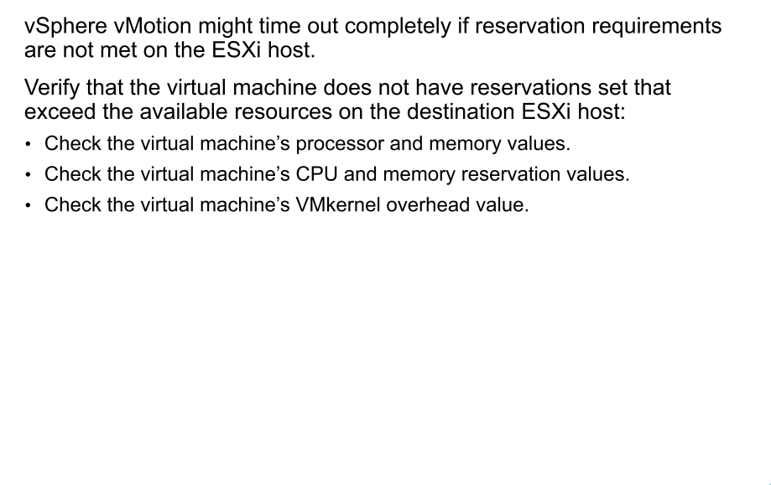
Possible Cause: Reservation Requirements Not Met

Slide 33
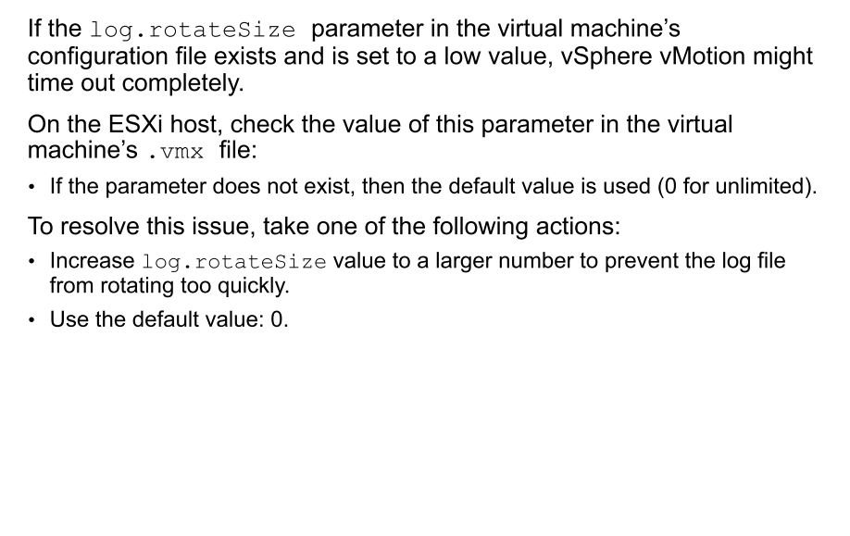
Possible Cause: log.rotateSize Set to Low Value

Slide 34
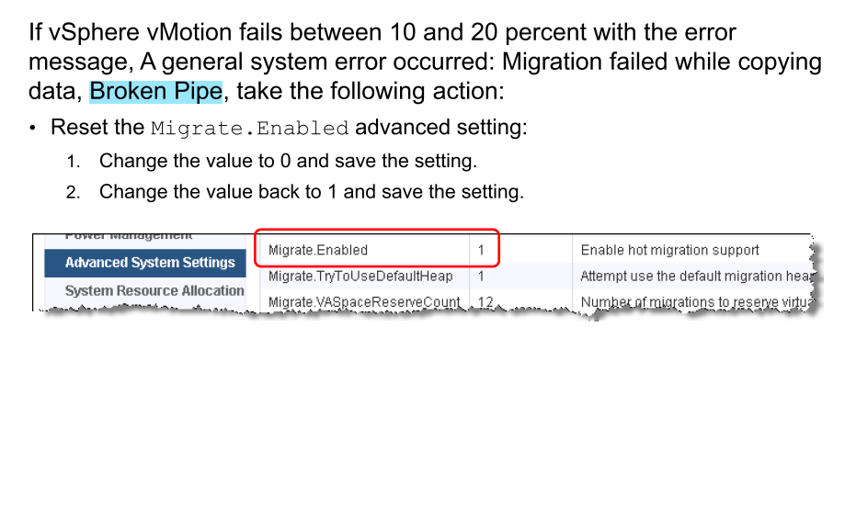
Resetting Migrate.Enabled

Slide 35
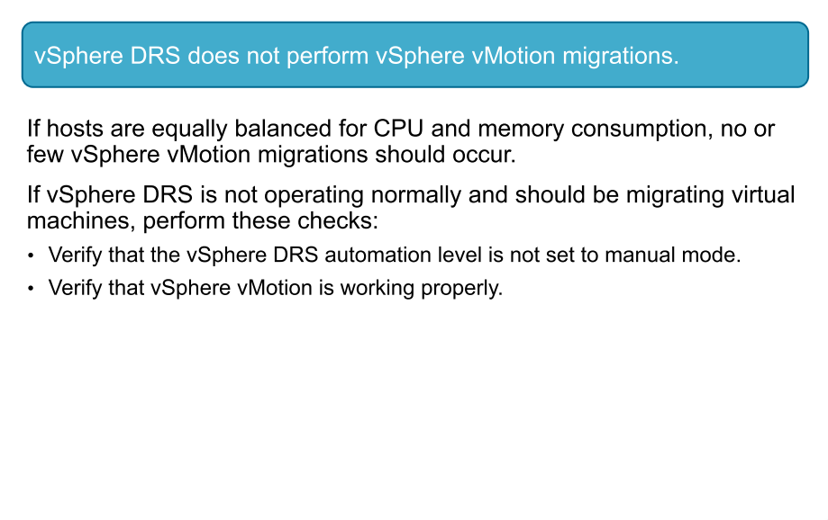
vSphere vMotion Problem 2

Slide 36
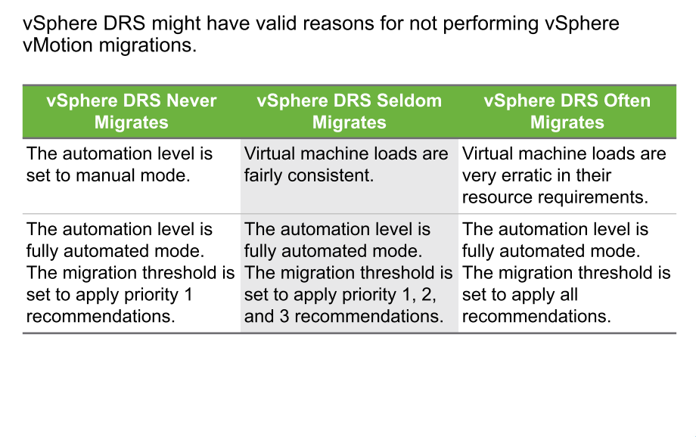
Possible Cause: vSphere DRS Configuration

Slide 37
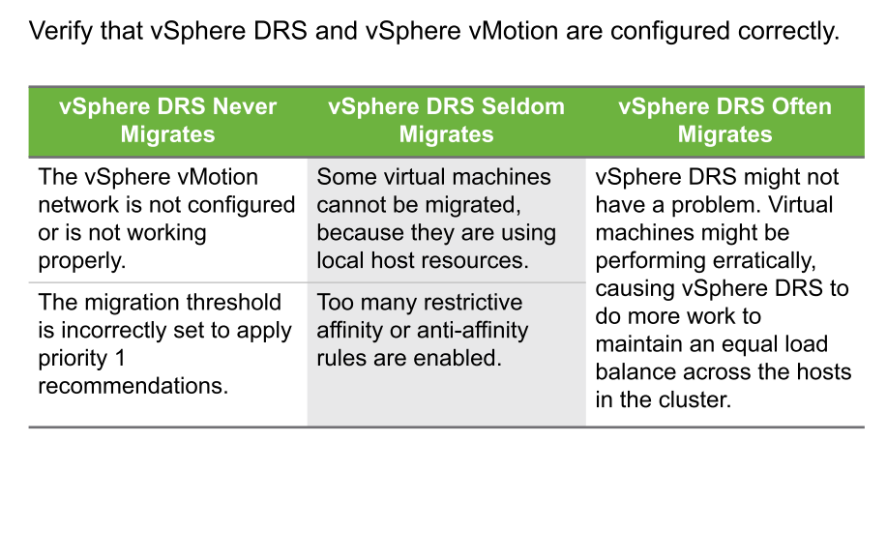
Possible Cause: Configuration Problems

Slide 38
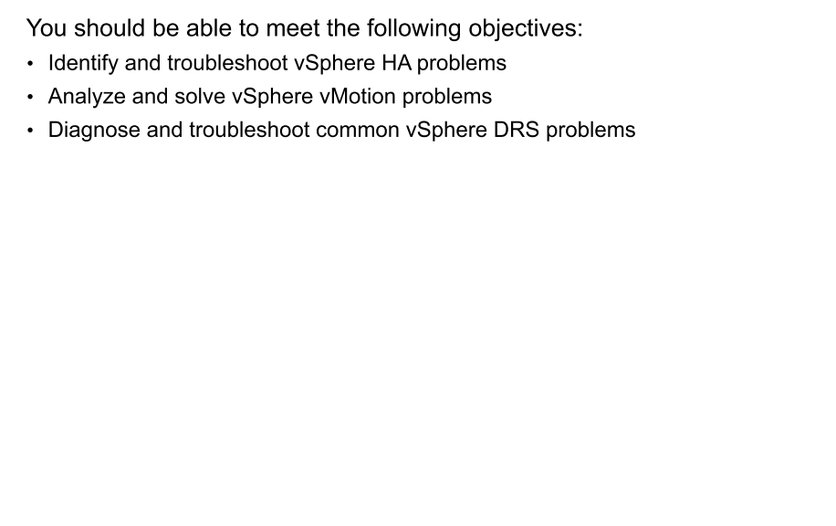
Review of Learner Objectives

